Slide 1
Lecture 6
Nusrat Jahan
Lecturer
Department of Software Engineering
Daffodil International University

Slide 2
Outline
Introduction
Data Definition Language
Data Manipulation Language
Data Control Language
Transaction Control Language

Slide 3
Entity Relationship Diagram
An Entity–relationship model (ER model) describes the structure of a database with the help of a diagram, which is known as Entity Relationship Diagram (ER Diagram).
An ER model is a design or blueprint of a database that can later be implemented as a database.
The main components of E-R model are:
  Entity set and
  Relationship set.

Slide 4
What is an Entity Relationship Diagram (ER Diagram)
An ER diagram shows the relationship among entity sets.
An entity set is a group of similar entities and these entities can have attributes.
In terms of DBMS, an entity is a table or attribute of a table in database, so by showing relationship among tables and their attributes, ER diagram shows the complete logical structure of a database.

Slide 5
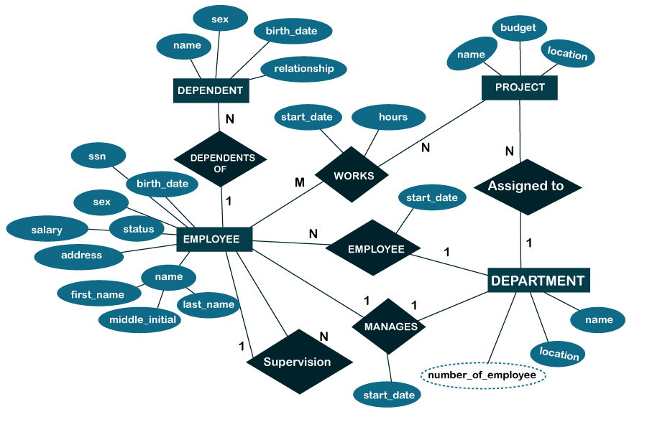
What is an Entity Relationship Diagram (ER Diagram)
Lets see an example of sample ER Diagram.
Sample ERD

Slide 6
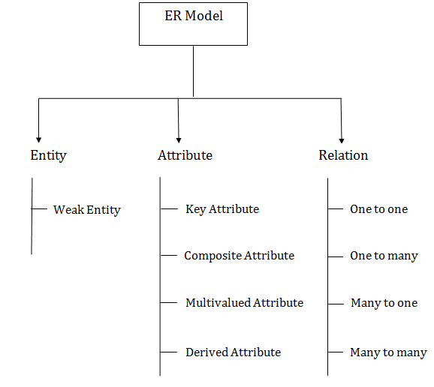
Component of Entity Relationship Diagram

Slide 7
Main Components of ER Diagram
An ER diagram has three main components:
Entity
Attribute
Relationship

Slide 8
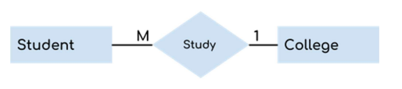
What is Entity?
An entity is an object or component of data. An entity is represented as rectangle in an ER diagram.
For example: In the following ER diagram we have two entities Student and College and these two entities have many to one relationship as many students study in a single college. We will read more about relationships later, for now focus on entities.

Slide 9
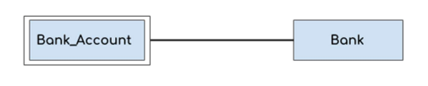
What is Weak Entity?
An entity that cannot be uniquely identified by its own attributes and relies on the relationship with other entity is called weak entity. The weak entity is represented by a double rectangle.
For example – a bank account cannot be uniquely identified without knowing the bank to which the account belongs, so bank account is a weak entity.

Slide 10
What is Attribute?
An attribute describes the property of an entity. An attribute is represented as Oval in an ER diagram.
There are four types of attributes:
  Key attribute
  Composite attribute
  Multivalued attribute
  Derived attribute

Slide 11
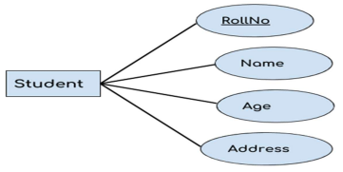
What is Key Attribute?
A key attribute can uniquely identify an entity from an entity set.
For example, student roll number can uniquely identify a student from a set of students. Key attribute is represented by oval same as other attributes however the text of key attribute is underlined.

Slide 12
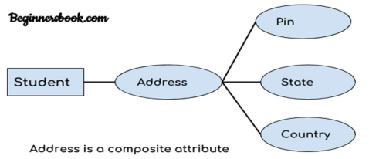
What is Composite Attribute?
An attribute that is a combination of other attributes is known as composite attribute.
For example, In student entity, the student address is a composite attribute as an address is composed of other attributes such as pin code, state, country.

Slide 13
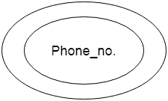
What is Multivalued Attribute?
An attribute that can hold multiple values is known as multivalued attribute. It is represented with double ovals in an ER Diagram.
For example – A person can have more than one phone numbers so the phone number attribute is multivalued.

Slide 14
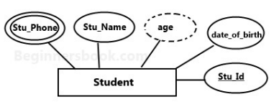
What is Derived Attribute?
A derived attribute is one whose value is dynamic and derived from another attribute. It is represented by dashed oval in an ER Diagram.
For example – Person age is a derived attribute as it changes over time and can be derived from another attribute (Date of birth).

Slide 15
What is Relationship?
Cardinality: Defines the numerical attributes of the relationship between two entities or entity sets.
A relationship is represented by diamond shape in ER diagram, it shows the relationship among entities.
There are four types of cardinal relationships:
  One to One
  One to Many
  Many to One
  Many to Many

Slide 16
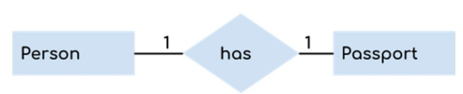
What is One to One Relationship?
When a single instance of an entity is associated with a single instance of another entity then it is called one to one relationship.
For example, a person has only one passport and a passport is given to one person.

Slide 17

What is One to Many Relationships?
When a single instance of an entity is associated with more than one instances of another entity then it is called one to many relationship.
For example – a customer can place many orders but a order cannot be placed by many customers.

Slide 18

What is Many to One Relationship?
When more than one instances of an entity is associated with a single instance of another entity then it is called many to one relationship.
For example – many students can study in a single college but a student cannot study in many colleges at the same time.

Slide 19
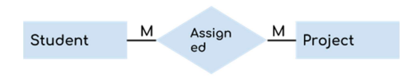
What is Many to Many Relationships?
When more than one instances of an entity is associated with more than one instances of another entity then it is called many to many relationship.
For example, a can be assigned to many projects and a project can be assigned to many students.

Slide 20
Example Of ER Diagram
A university consists of a number of departments. Each department offers several courses. A number of modules make up each course. Students enrol in a particular course and take modules towards the completion of that course. Each module is taught by a lecturer from the appropriate department, and each lecturer tutors a group of students

Slide 21
Example - Entities
A university consists of a number of departments. Each department offers several courses. A number of modules make up each course. Students enrol in a particular course and take modules towards the completion of that course. Each module is taught by a lecturer from the appropriate department, and each lecturer tutors a group of students

Slide 22
Example - Relationships
A university consists of a number of departments. Each department offers several courses. A number of modules make up each course. Students enrol in a particular course and take modules towards the completion of that course. Each module is taught by a lecturer from the appropriate department, and each lecturer tutors a group of students

Slide 23
Example - E/R Diagram
Entities: Department, Course, Module, Lecturer, Student
Department
Course
Module
Lecturer
Student

Slide 24
Example - E/R Diagram
Each department offers several courses
Offers
Department
Module
Lecturer
Course
Student

Slide 25
Example - E/R Diagram
A number of modules make up each courses
Offers
Department
Course
Includes
Module
Lecturer
Student

Slide 26
Example - E/R Diagram
Students enrol in a particular course
Offers
Department
Includes
Course
Module
Lecturer
Enrols In
Student

Slide 27
Example - E/R Diagram
Students … take modules
Offers
Department
Course
Includes
Module
Lecturer
Takes
Enrols In
Student

Slide 28
Example - E/R Diagram
Each module is taught by a lecturer
Offers
Department
Course
Includes
Module
Teaches
Lecturer
Takes
Enrols In
Student

Slide 29
Example - E/R Diagram
a lecturer from the appropriate department
Offers
Department
Employs
Course
Includes
Module
Teaches
Lecturer
Takes
Enrols In
Student

Slide 30
Example - E/R Diagram
each lecturer tutors a group of students
Offers
Department
Employs
Course
Includes
Module
Teaches
Lecturer
Takes
Enrols In
Student
Tutors

Slide 31
Example - E/R Diagram
Offers
Department
Employs
Course
Includes
Module
Teaches
Lecturer
Takes
Enrols In
Student
Tutors

Slide 32
Example - E/R Diagram
Offers
Department
Employs
Course
Includes
Module
Teaches
Lecturer
Takes
Enrols In
Student
Tutors

Slide 33
Example - E/R Diagram
Course
Has
Course_Module
Has
Module

Slide 34
References
https://www.javatpoint.com/dbms-notation-of-er-diagram
https://www.javatpoint.com/dbms-er-model-concept

Slide 35
Thank You

